Slide 1

Implementation of Stream Clustering Algorithm
By Chaitanya Vallabhaneni,
Ishani Ghose &
Kaushik Vakadkar

Slide 2
Goal of our Project
Implementation of stream clustering algorithms in Python.
Analysis of its performance using the Sum of Squared Distances (SSQ) metric with weather sensor data to evaluate potential use of the algorithm in IOT devices.

Slide 3
Data
Weather sensor data was used.
The input is in the form of a log file with each data point having the following attributes: data, time, temperature(R), humidity(R), light(R), voltage(R), epoch(I) and moteid(I). R = Real number, I = Integer.
The size of the data set is 150 MB. While the data is statically stored, a stream of data is generated from it.

Slide 4
Data
The Stream_lsearch algorithm is run over sensor data by simulating a stream over 20,000 data points by taking chunks of 1000 data points running kmedians over it to search for k centres. The last 4 attributes of the raw data: Temperature, Humidity, Light and Voltage were used to form the clusters.
As the different attributes lied in extremely different range, each value was normalized by the following formula: Norm_val = (val - min)/(max-min)
The ranges of the 4 features are:
Temperature (-5,100)(degree celsius)
Humidity (0,100%)
Light: (0,100000)(flux)
Voltage (2,3)

Slide 5
Algorithms Implemented
Stream LSEARCH: The implementation of the clustering subroutine (LSEARCH) used for a given set of points is available in C++. We have implement this in Python. This algorithm takes an upper and lower bound on the number of clusters that the algorithm can create and then performs a local search on it.

Slide 6
High Level Pseudocode of kmedains(kmax,kmin)
Z = 0
Z_max = summation (distance(x,x0)) where x0 is chosen as the first point in the chunk
Z_min = 0
Z = (zmax + zmin)/2
I,a = Estimate an initial solution by calling function speedy2
If number of centres identified < kmax: return solution
Shuffle data
(I,a) = Keep estimate a solution until number of centres is >= kmin
Randomly pick theta((1/p)logk) points as median
While k is outside the range(kmin, max) and zmax - zmin > 0.0001:
Let (F, g) be the current solution
Run F L(N, d, ,(F, g)) to obtain a new solution (F0 , g0 )
If |F0 | is “about” k, then (F0 , g0 ) ← F L(N, d, 0 ,(F0 , g0 ))
If |F0 | > k then {zmin ← z and z ← (zmax + zmin)/2};
else if |F0 | > k then {zmax ← z and z ← (zmax + zmin)/2}
To simulate a continuous space call contcenters, move each cluster center to the center-of-mass for its cluster
Return our solution (F0 , g0 )

Slide 7
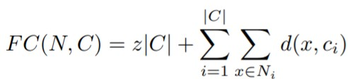
Minimized Expression
The Lsearch algorithm minimizes the sum of square distances of each point from the closes cluster and the total cost to keep the facility centres open.

Slide 8
Results
SSQ on stream of 20000 data points broken into chunks of 1000 data points averaged over 10 runs:
Number of centres:k=62. SSQ=1.97
Kmeans clustering run over the static dataset of 20000 points for
k=62. SSQ: 1.48
The statistics of the centres for each attribute in comparison to the statistics of the entire data
Standard deviation of centres:[1.258e+01, 7.179e+00, 1.776e+02, 9.189e-02]
True std_dev: [3.298e+00, 4.937e+00, 1.771e+02, 5.172e-02]
Mean of centres: [ 23.443, 35.917, 165.642, 2.644]
True mean: [ 21.925, 36.895, 156.644, 2.654]

Slide 9
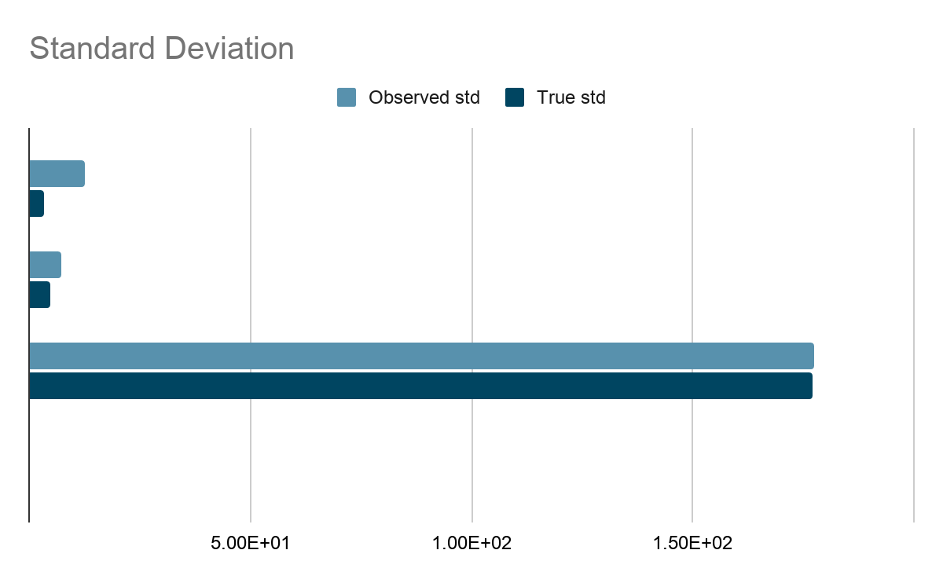
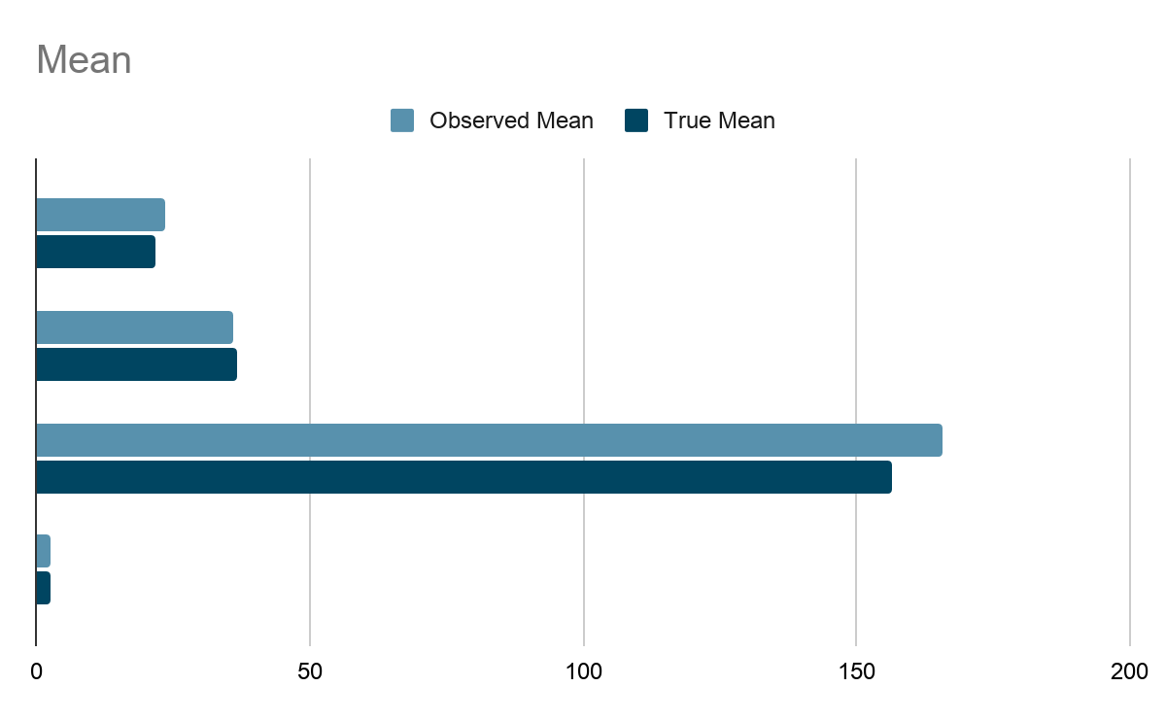

Slide 10
Performing stream lsearch over a stream of 2000 points broken into 2 chunks

Slide 11
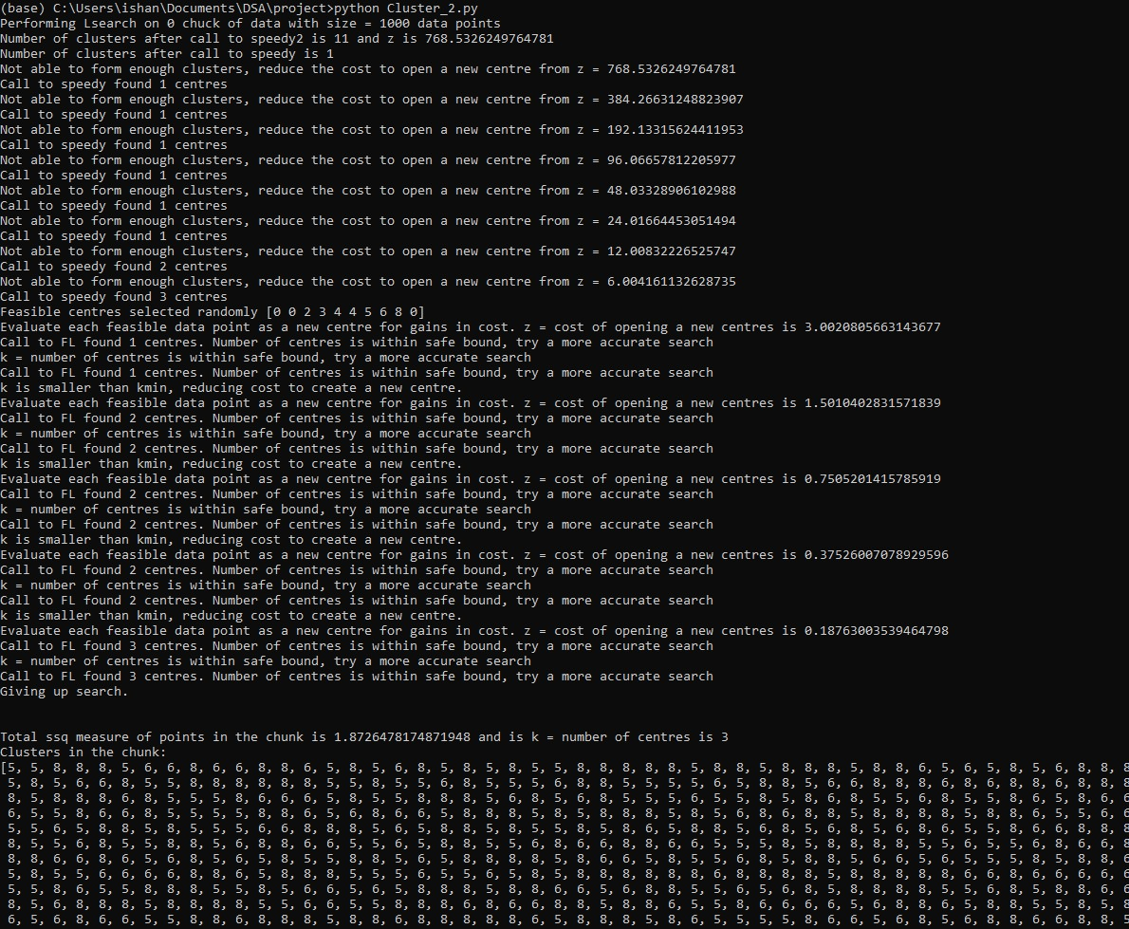

Slide 12
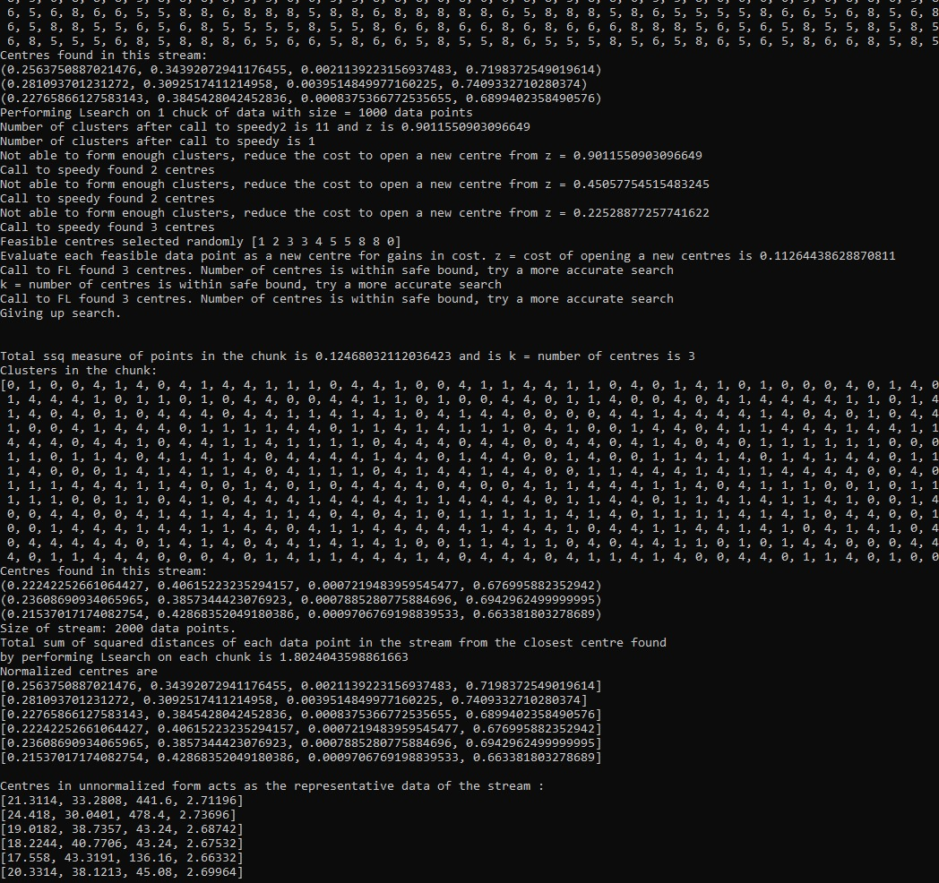
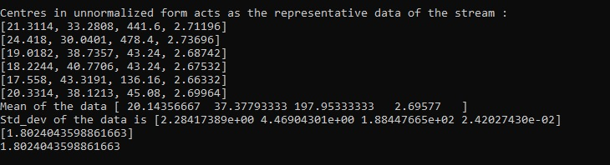

Slide 13
Running Time
The running time of kmedians is O(nm + nk log k) where m is the number of facility centres opened during speedy2.
Across chunks of 1000 data points, the number of centres opened by speedy2 was 12 on an average.
N is the size of the chunk and k is the number of medians.

Slide 14
Space Complexity
If the number of centres being maintained across all the chunks of data exceeds a pre-specified limit, max_centres, kmedian is called on the list of centres to reduce the amount of memory required to O(k_max) again. However, the amount of space required to store the centres in addition to the space required to run the algorithm is O(max_centres).
The space required to run the algorithm is O(size of a chunk).

Slide 15
References
https://www.cs.princeton.edu/courses/archive/spr05/cos598E/bib/stream_icde.pdf
http://db.csail.mit.edu/labdata/labdata.html

Slide 16
Thank You

